Slide 1
World Happiness
Presented by: Rohan Kumar
Last Updated : October 15th ,2023

Slide 2
Table of Content
World Happiness
Purpose Statement (What are we talking about?)
Tell Your story (with Data)
Conclusion
Appendix

Slide 3
What are we talking about?

Slide 4
Objective
Identify if there are geographic ,demographic and/or economic factors that contribute to happier life.

Slide 5
Present data

Slide 6
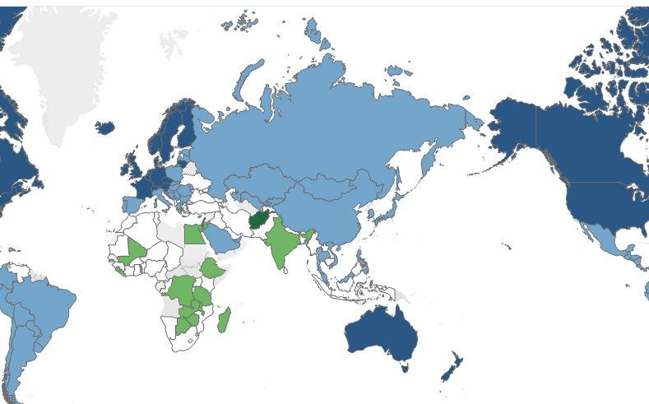
Geographic
Happiness levels vary widely by country
Little correlation between geographic location and happiness.
Geographic location is not a strong indicator of happiness.

Slide 7
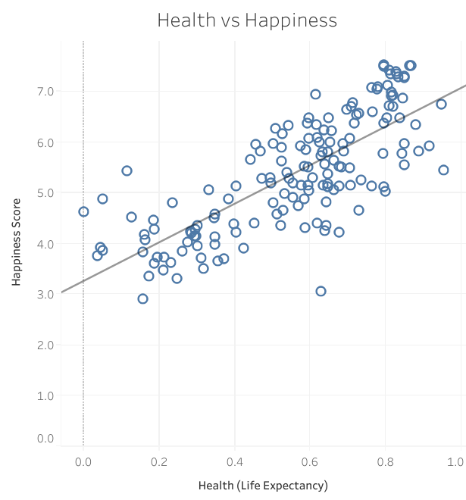
Health
Positive correlation between happiness and health( life expectancy)
Are happy people healthy , or are healthy people happy?
What contributes to a longer life expectancy?

Slide 8
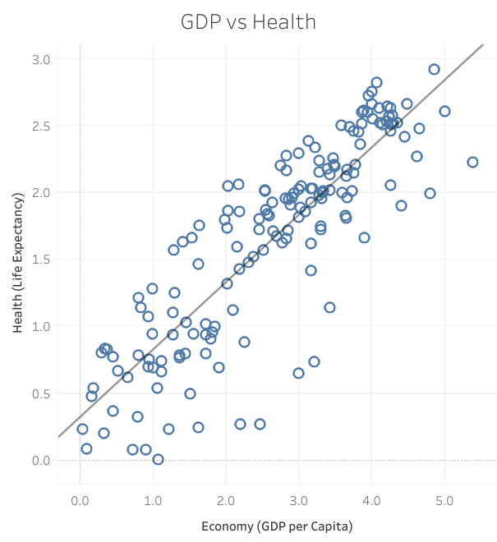
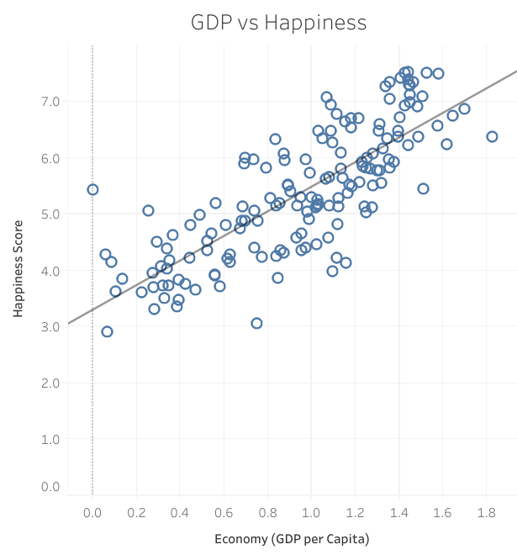
Wealth
Strong correlation between Gross Domestic Product (GDP) and Health
Even stronger correlation between GDP and Happiness.
Richer countries have higher average happiness levels

Slide 9
Conclusion

Slide 10
Conclusions
Wealthier countries and ones Healthier countries also tend Evidence suggest that wealth,
that have sustained economic to have a happier population. Health and happiness
growth tend to have higher go together.
average happiness levels. However, healthier countries
also tend to be wealthy.
1
2
3

Slide 11
Thank You

